Slide 1
MFET 348 Final Project Presentation
- Singhal, Saurabh

Slide 2
Project motivation:
A robot that can cook food
Simplified the problem to cut an onion
Cutting an onion can give you tears
- Singhal, Saurabh

Slide 3
Project walkthrough:
Defined the counter’s transformation matrix with respect to robot’s base using Spatial description and transformation.
Defined the points’ transformation matrices in robot’s reference frame using forward kinematics.
Planned the trajectory of the robot’s end-effector using trajectory planning in cartesian space.
Found robot angles using inverse kinematics.
- Singhal, Saurabh

Slide 4
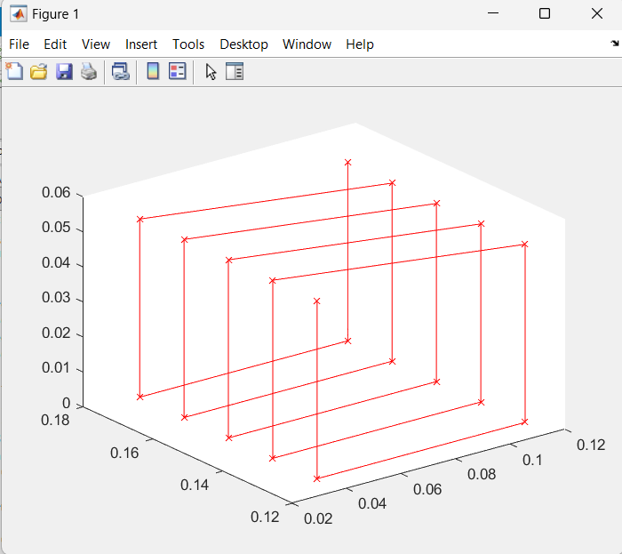
Path followed by the robot:
- Singhal, Saurabh

Slide 5
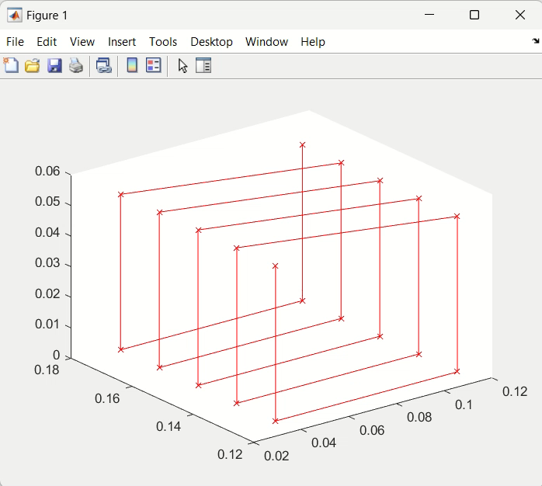
Demo:
- Singhal, Saurabh

Slide 6
Thank you

